Slide 1
Career Solutions is dedicated to helping our community grow by meeting the workforce needs of businesses and job seekers now and in the future.

Slide 2
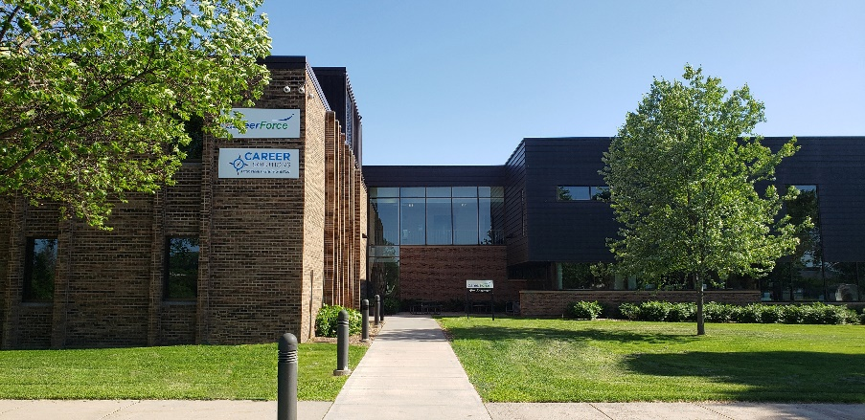
Career Solutions - About Us
Career Solutions is dedicated to helping our community grow by meeting the workforce needs of businesses and job seekers now and in the future.
Primary Service Area:
Stearns and Benton Counties
Customers:
Job Seekers: youth-adults, entry-level to executive level
Employers
Funding:
State and Federal Funding
Local grants
Location:
North side of the St. Cloud Technical & Community College
Partner: in CareerForce - St. Cloud

Slide 3
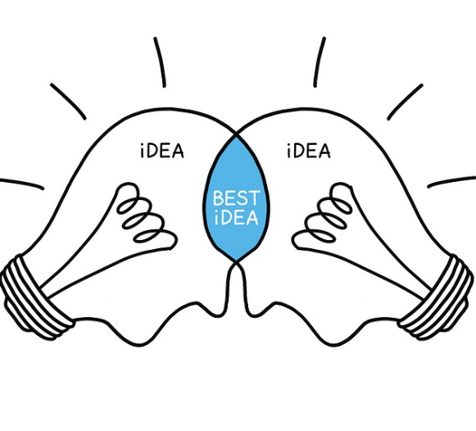
About Us - Collaboration
Career Solutions collaborates with many community partners to identify and address employment needs of businesses and job seekers.
These partners include:
Employers
Citizens
Government agencies
Economic development agencies
Social service agencies
Educational institutions

Slide 4
What We Do…
Career Solutions is an employment and training agency that assists our community in building a skilled workforce.
Invest in people and businesses
Career Solutions helps individuals train for and gain meaningful employment Through:
One-on-one Career counseling
Job training
Business relationships
This includes:
Entry-level to experienced workers
Youth to older adults
CareerSolutionsJobs.org

Slide 5
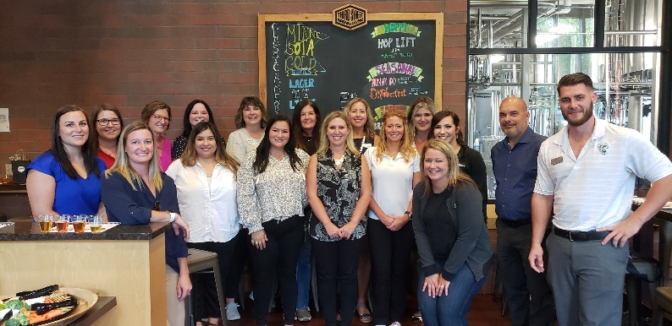
Career Solutions Business Services
Career Solutions helps businesses:
Source
Train AND
Retain workers
We focus on providing a pool of qualified workers who will help businesses grow
Business Services:
Recruitment: access to dislocated workers, other job seekers & other contacts
On-the-Job Training
Incumbent Worker Training
Monthly HR Networking Group
Immigrant Services

Slide 6
Dislocated Worker Program
Eligibility:
18 and older AND
Permanently separated from employment due to no fault of their own
15 of the past 52 weeks unemployed
Goal:
To ensure job seekers are able to secure permanent jobs in high-demand occupations as soon as possible
Services:
Career Counseling, Training, On the Job Training (OJT), Job Search Assistance, Resume Expertise, Interview Assistance, HR Connections

Slide 7
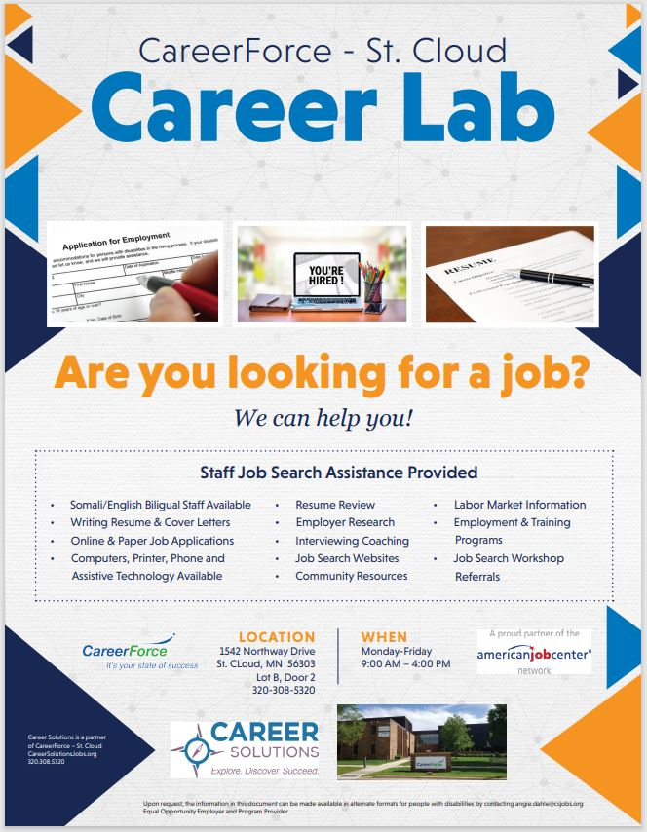
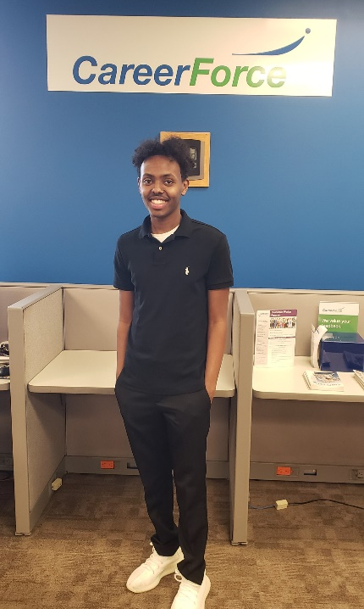
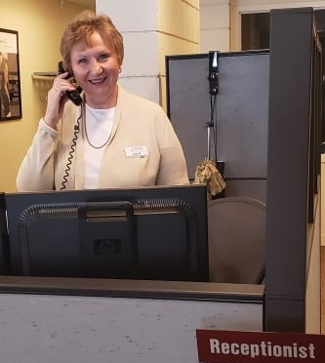
Career Lab

Slide 8
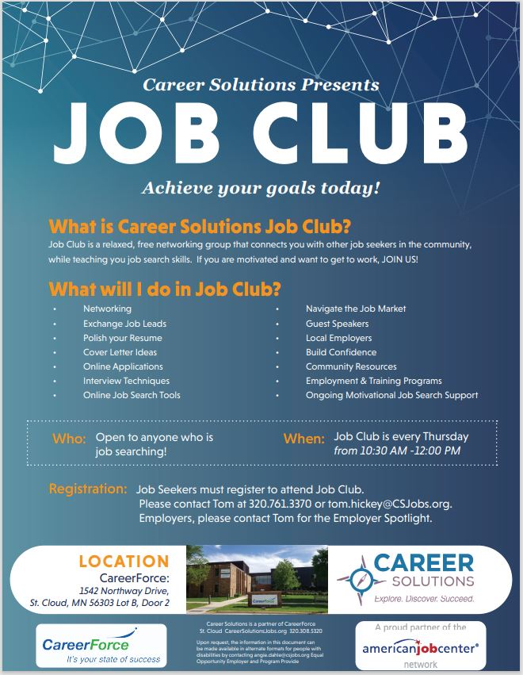
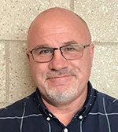
Job Club
Job Club Facilitator/ Career Planner: Tom

Slide 9
Human Resources Networking Group
Purpose: This monthly group allows HR professionals to:
Share best practices
Brainstorm
Collaborate
Network with other HR professionals
Gain information about workforce development events, programs and training
Facilitator: Angie.Dahle@CSJobs.org 320.308.5334

Slide 10
Additional Job Search Resources (available to the public)
Free Online CareerForce Job Search Workshops:
Resume Writing
Interviewing
Career Exploration
Networking
Resume Writing Advanced
Register: www.careerforcemn.com/saintcloud
MN Works Job Bank: www.minnesotaworks.net/
Career Solutions Favorite Job Search Resources: https://careersolutionsjobs.org/job-seekers/job-search-resources/
Local Job Fairs:
www.careerforcemn.com/attend-career-fairnetworking-event

Slide 11
Questions or Comments?
Contact us! 320-308-5320
CareerSolutionsJobs.org

